Slide 1
Chapter 2 (part1) Instructor: Shuchi Jain Virginia Commonwealth University
STAT 441

Slide 2
Descriptive Statistics
To present graphical and numerical methods for exploring, summarizing, and describing data

Slide 3


Descriptive Statistics
How can you organize and summarize the data set to make it more comprehensible and meaningful?
These involve graphs and charts that rapidly convey a visual picture of the data, and numerical measures that describe certain features of the data.
Procedure to use depends on the type of data (quantitative or qualitative) that we want to describe

Slide 4
Graphical and Numerical Methods for Describing Qualitative Data
When describing qualitative observations, we define the categories in such a way that each observation can fall in one and only one category (or class).
The data set is then described numerically by giving the number of observations, or the proportion of the total number of observations, that fall in each of the categories.

Slide 5
Definitions
A class is one of the categories into which qualitative data can be classified.
The category (or class) frequency for a given category is the number of observations that fall in that category.
The category (or class) relative frequency for a given category is the proportion of the total number of observations n that fall in that category, i.e.

Slide 6
Summary Frequency Table for Cause of Energy-Related Fatal Accidents
Category (Cause) Frequency (Number of Accidents) Relative Frequency
Coal mine collapse 9 .145
Dam failure 4 .065
Gas explosion 40 .645
Nuclear reactor 1 .016
Oil fire 6 .097
Other (Lightening) 2 .032
Totals 62 1.000

Slide 7
Graphical descriptions of qualitative data
Bar graphs give the frequency (or relative frequency) corresponding to each category, with the height or length of the bar proportional to the category frequency (or relative frequency).

Slide 8
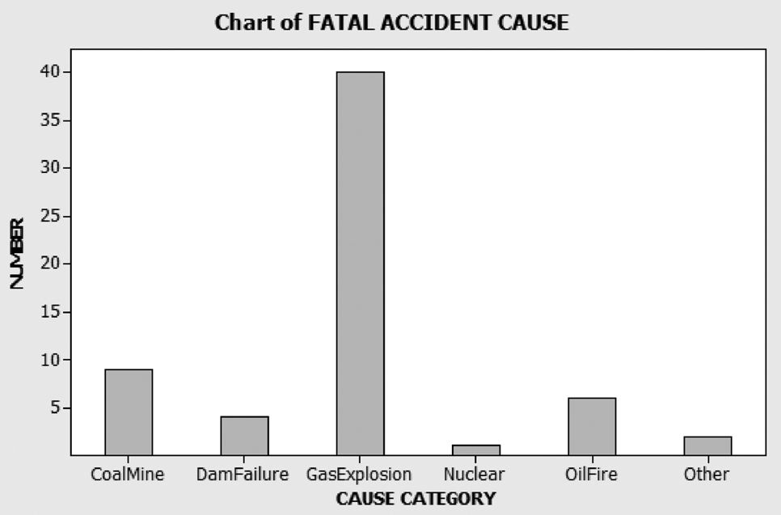
Bar Graph

Slide 9
Pie Charts
Pie charts divide a complete circle (a pie) into slices, one corresponding to each category, with the central angle of the slice proportional to the category relative frequency.

Slide 10
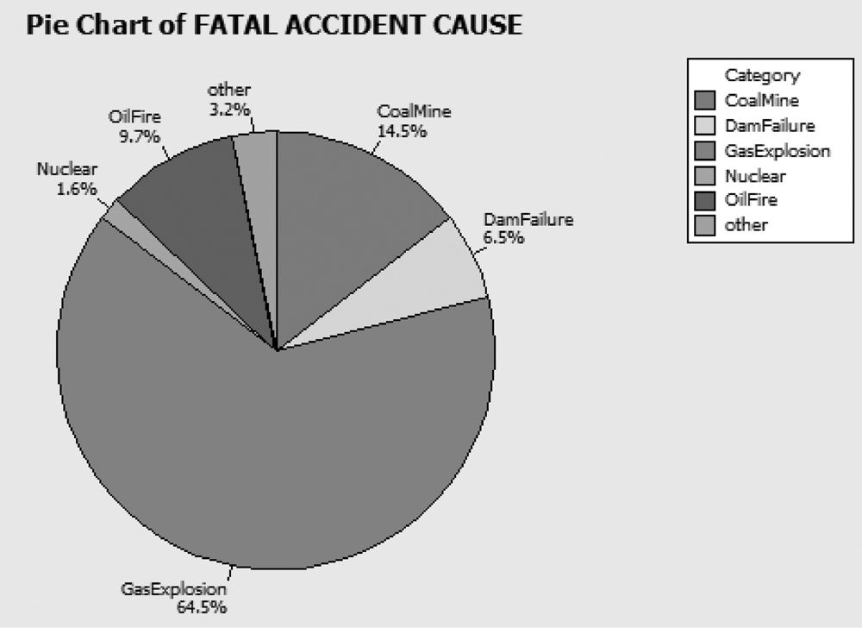
Pie Chart

Slide 11
Graphical Methods for Describing Quantitative Data
Quantitative data sets consist of data that are recorded on a meaningful numerical scale. For describing, summarizing, and detecting patterns in such data, we can use three graphical methods:
dot plots,
stem-and-leaf displays,
and histograms.

Slide 12
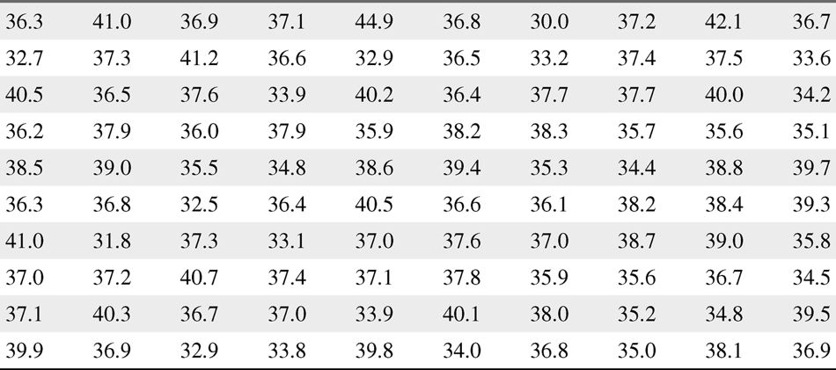
EPA Mileage Ratings on 100 Cars

Slide 13
Dot Plot
Dot Plot: The numerical value of each quantitative measurement in the data set is represented by a dot on a horizontal scale. When data values repeat, the dots are placed above one another vertically.

Slide 14
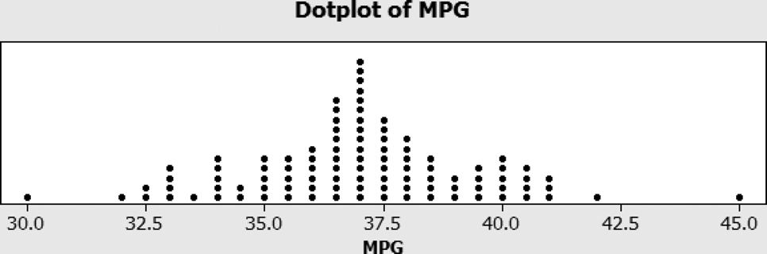
Dot Plot for EPA mileage data

Slide 15
Stem-and-Leaf Display
The numerical value of the quantitative variable is partitioned into a “stem” and a “leaf.” The possible stems are listed in order in a column. The leaf for each quantitative measurement in the data set is placed in the corresponding stem row. Leaves for observations with the same stem value are listed in increasing order horizontally.

Slide 16
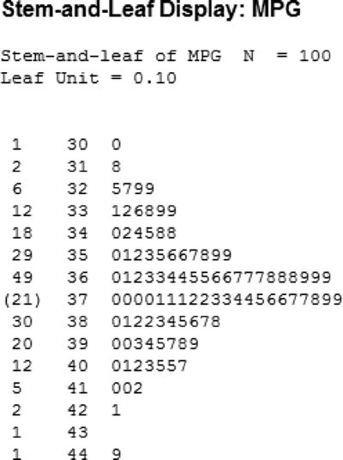
Stem and Leaf Plot

Slide 17
Histograms
Histograms can be used to display either the frequency or relative frequency of the measurements falling into the class intervals.

Slide 18
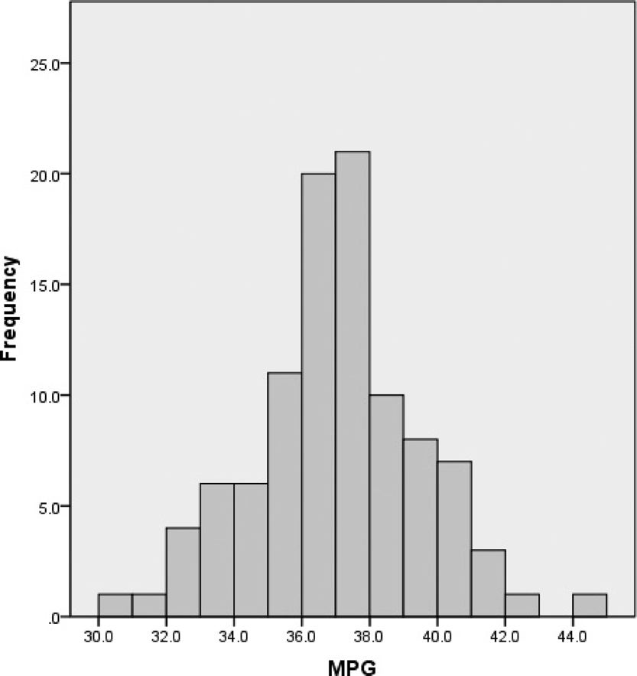
Histogram for EPA Gas Mileage Ratings

Slide 19
Class Intervals, Frequencies, and Relative Frequencies for the Car Mileage Data
Class Interval Frequency Relative Frequency
30–31 1 .01
31–32 1 .01
32–33 4 .04
33–34 6 .06
34–35 6 .06
35–36 11 .11
36–37 20 .20
37–38 21 .21
38–39 10 .10
39–40 8 .08
40–41 7 .07
41–42 3 .03
42–43 1 .01
43–44 0 .00
44–45 1 .01
Totals 100 1.00

Slide 20
Steps to Follow in Constructing a Histogram
Step 1: Calculate the range of the data:
Step 2: Divide the range into between 5 and 15 classes of equal width. Use a small number of classes for a small amount of data and a larger number of classes for larger data sets

Slide 21
Steps to Follow in Constructing a Histogram
Step 3: For each class, count the number of observations that fall in that class. This number is called the class frequency.
Step 4: Calculate each class relative frequency:

Slide 22
Steps to Follow in Constructing a Histogram
Step 5: The histogram is essentially a bar graph in which the categories are classes. In a frequency histogram, the heights of the bars are determined by the class frequency. Similarly, in a relative frequency histogram, the heights of the bars are determined by the class relative frequency.

Slide 23
Most statistical software packages can be used to generate histograms, stem-and-leaf displays, and dot plots.
You'll find that histograms are generally more useful for very large data sets, while stem-and-leaf displays and dot plots provide useful detail for smaller data sets.

